Slide 1
Introduction to Fintech
Introduction to Fintech
Prof. Xiaoyu (Joanan) Wang
Peking University

Slide 2
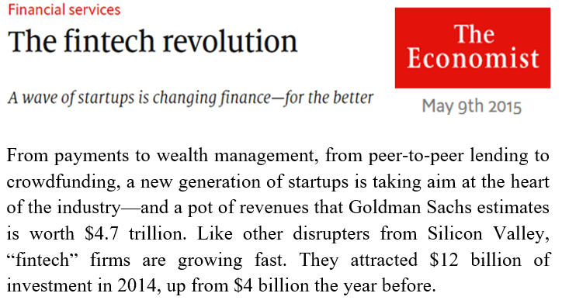
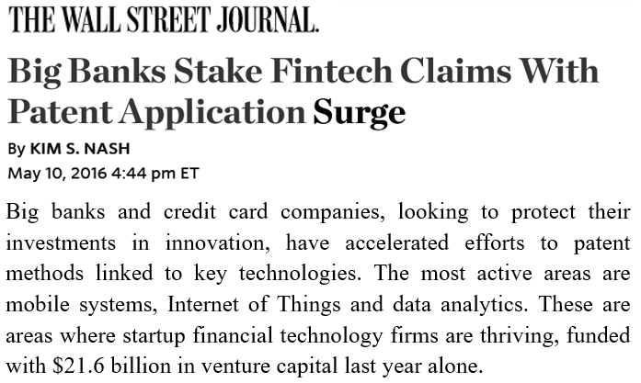

Slide 3
What is FinTech?
Financial Technology
The application of information technology in financial services industry
The rapid development of information technology is leading to a revolution/disruption in financial services
Internet, smart phones
Cloud computing
Big data, data analytics, artificial intelligence
Blockchain
Internet of things

Slide 4





What Does FinTech Include?
Blockchain
Mobile Transactions
Cybersecurity
Data Analytics
P2P Financing
Robo-advising
Internet of Things
Big data, machine learning, AI, cloud computing
Biometrics, encryption, tokenization
Digital wallets, smartphone wallets, near-field communication
Bitcoin, cryptocurrency, distributed ledgers
Crowdfunding, crowdlending
Artificial intelligence, big data
Smart devices, wireless sensor networks

Slide 5
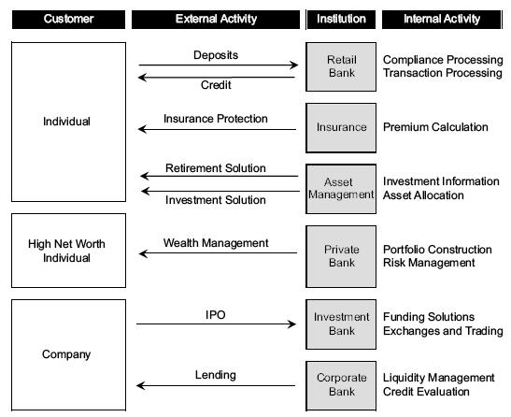
Financial Institutions and Their Activities
Source: Gupta and Tham (2018)

Slide 6
Traditional Financial Institutions
Payment: Visa, Mastercard, etc.
Consumer Banking and Lending: Bank of America, Citibank, Chase, etc.
Investment Banking and Brokerage: Goldman Sachs, Morgan Stanley, NYSE (ICE), Nasdaq, etc.
Asset Management: Fidelity, Vanguard, Blackrock, Bridgewater Associates, SAC Capital Advisors, etc.

Slide 7
FinTech Disruption
Advances in technology lead to waves of recent innovation and disruption in finance
Payment: PayPal, Apple Pay, Venmo, Square
Consumer Banking: Internet and Mobile Banks
Lending: P2P lending, LendingClub, Prosper, Crowdfunding
AI and analytics: fraud detection, marketing
Robo-advising: Wealthfront, Betterment
Blockchain: Cryptocurrencies, Banking, Payment, Financing, Supply Chains, HealthCare, InsurTech, etc.
RegTech: Compliances (e.g., smart court), Know your customer (KYC)
InsurTech: internet of things, analytics

Slide 8
Impact of FinTech
Businesses
Improve efficiency for existing financial companies
Allow newcomers to disrupt existing business
Consumers
Better service
Lower costs

Slide 9
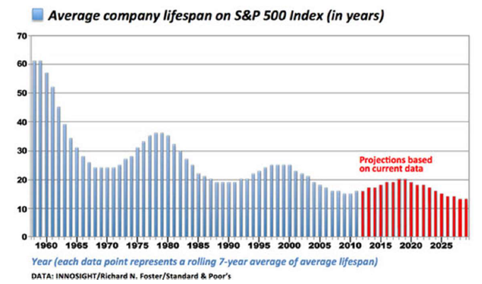
Harder to Stay on Top

Slide 10
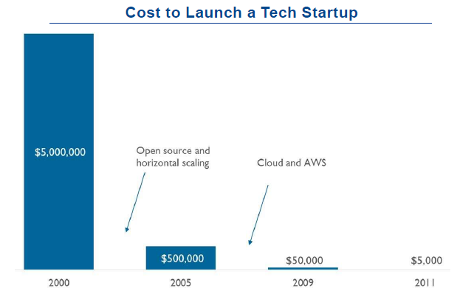
Lower Entrance Cost
Source: Upfront Ventures

Slide 11
Disruptive Innovation
Disruption describes a process whereby a smaller company with fewer resources is able to successfully challenge established incumbent businesses
Different types of disruptive innovation
Low-end disruption
New companies start by innovating in the low-end market
Incumbents tend to guard the high-end market more closely
New market disruption
Newcomers create a new market or convert non-consumers to consumers
Big bang disruption
Startups attack the existing market on all fronts at once, employing new technology and business model, e.g., smart phone navigator vs GPS

Slide 12
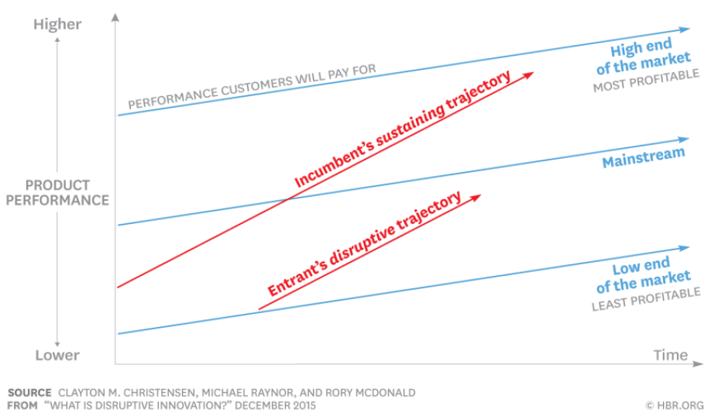
Disruptive Innovation

Slide 13
Economics of Big-Bang Disruption
Declining costs of
Creation: raw materials, supply chains, hardware and software
Information: social network, reviews
Experimentation: internet, mobile network
The “Shark Fin”
A principal-guaranteed structured product with a lockup period. It combines a high annual percentage rate (APR) with financial derivatives highly popular within the crypto markets.
Big-bang disruptors reach market penetration and saturation relatively quickly

Slide 14
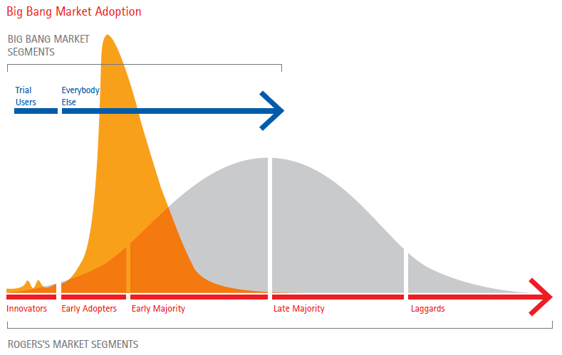
Big Bang Market Adoption
Source: Accenture

Slide 15
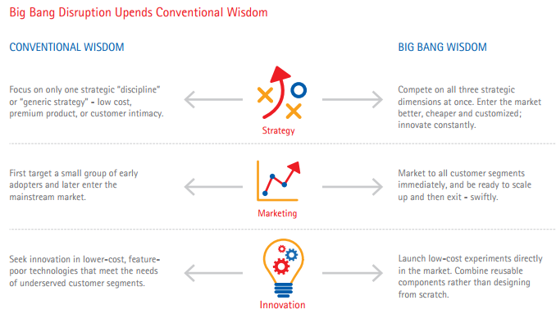
Big Bang Disruption
Source: Accenture

Slide 16
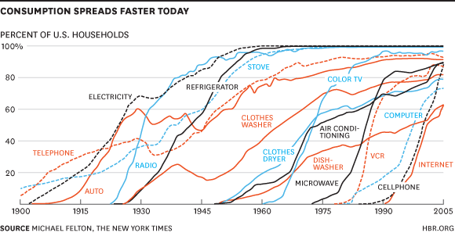
Technology Adoption is Faster

Slide 17
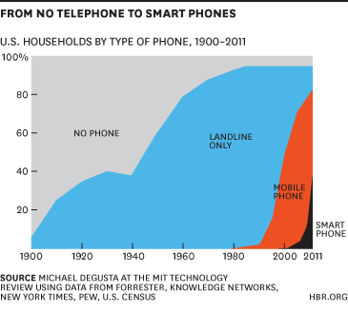
Technology Adoption is Faster

Slide 18
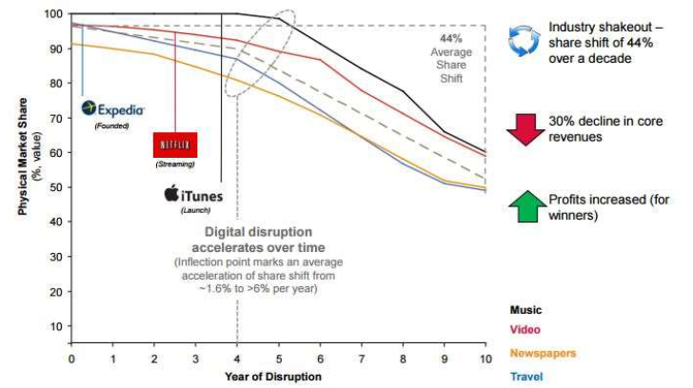
Digital Disruption

Slide 19
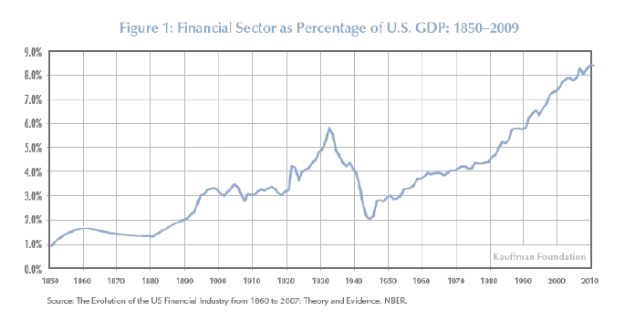
Importance of the Financial Sector

Slide 20
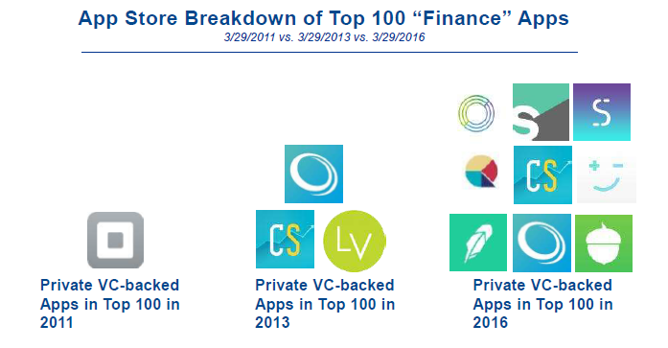
Direct Reach to Customers
Source: CB Insights

Slide 21
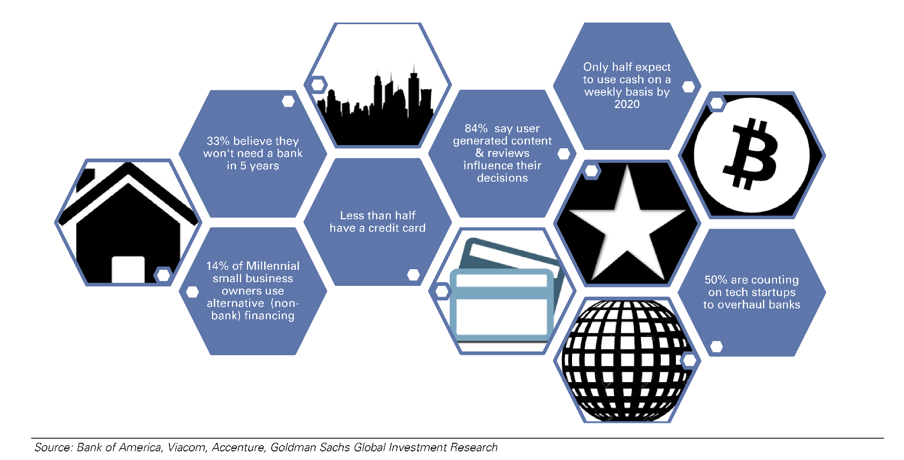
Millennials and FinTech
21

Slide 22
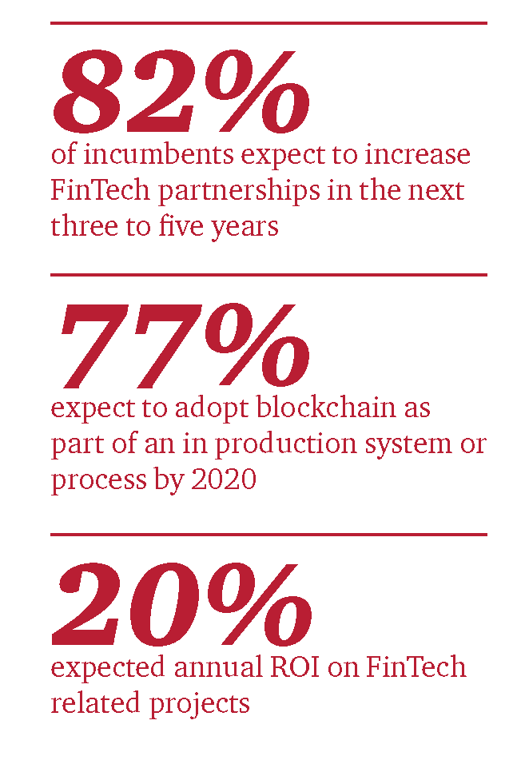
Impact of FinTech on Financial Services
Source: PwC Global FinTech Report 2017

Slide 23
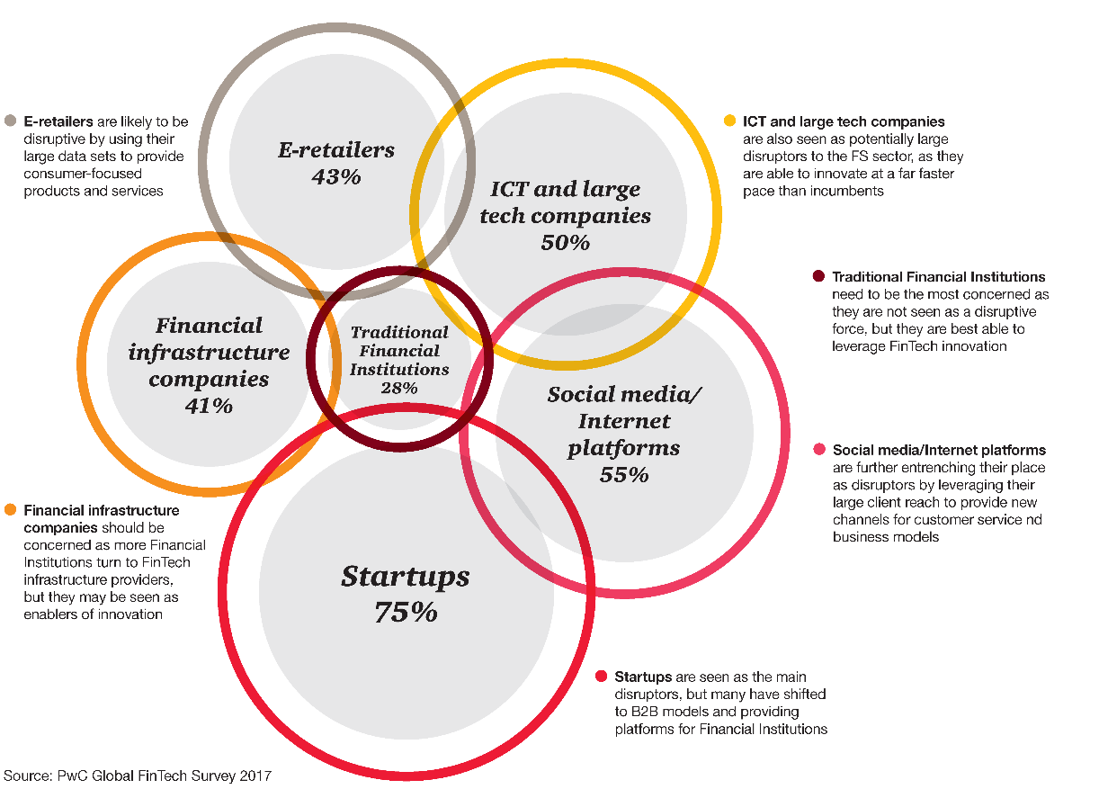
FinTech and Disruptive Entities

Slide 24
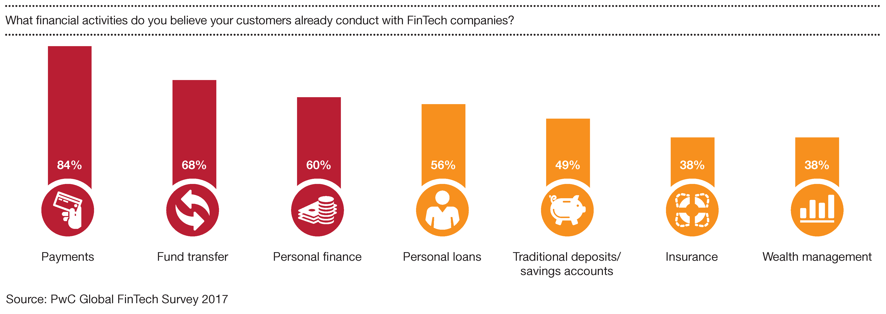
Activities incumbents believe consumers are already conducting with FinTech companies

Slide 25
Crowd-funding
Source funding across a network of supporters
Can disrupt venture capital, production financing, and media finance channels
Different formats
Donation-based: GoFundMe
Rewards-based: Kickstarter, Indiegogo
Equity investment: AngelList
Initial Coin Offerings: token issuance via blockchains (later)

Slide 26
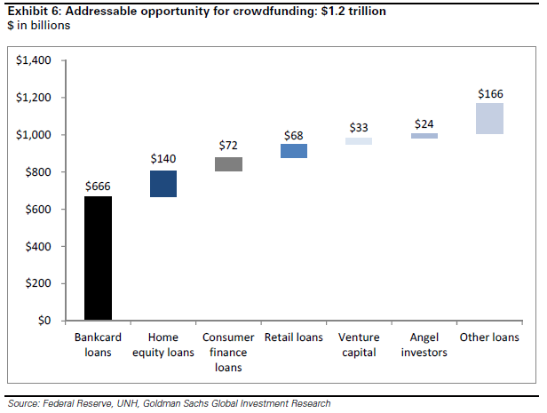
Potential Disruption by Crowd-Funding

Slide 27
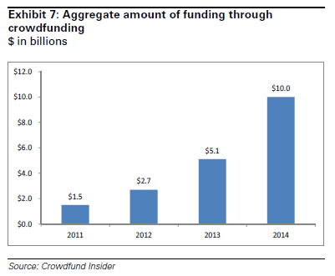
Scale of Crowd-funding

Slide 28
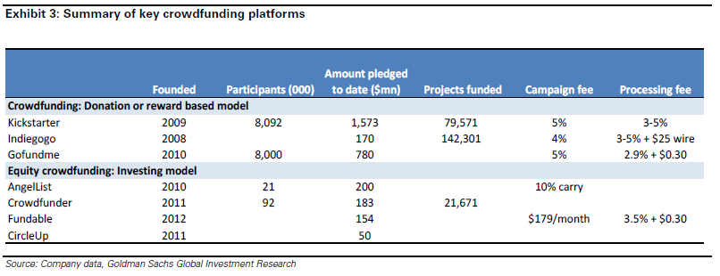
Scale of Crowdfunding

Slide 29
Enablers of Growth for Crowdfunding
Expanding innovation of crowdfunding
Changing demographics and consumer behavior
Viral growth
Strong network effects
Regulatory changes

Slide 30
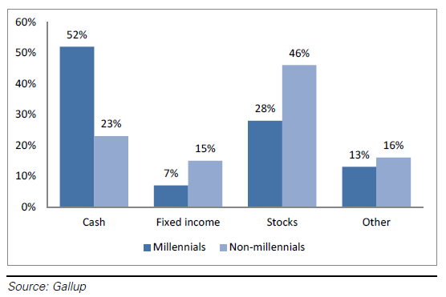
Millennials are less likely to hold stocks

Slide 31
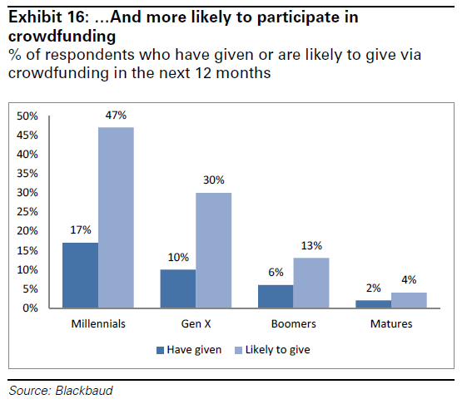
… and more likely to give

Slide 32
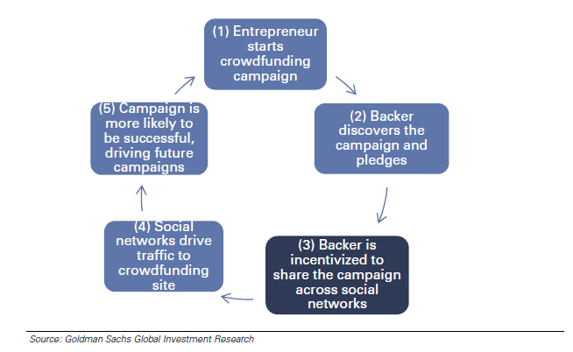
Strong Network Effects

Slide 33
Regulatory Changes
Original rules of Regulation D does not allow solicitation of general investors unless the issuer is involved in a public offering
“advertisements published in newspapers and magazines, public websites, communications broadcasted over television and radio, and seminars where attendees have been invited by general solicitation or general advertising”
JOBS Act in 2012
Reduce barriers for small companies to obtain financing
Amendments in 2013: Allow general solicitation if all purchasers are accredited investors and the issuer takes reasonable steps to verify the accredited investor status

Slide 34
Wealth Management and Robo-advising
Automation
Passive investing
Exchange-Traded Funds (ETF) that track an index portfolio
Ease of Use
Online or Mobile-first interface
Transparent and Low Fees

Slide 35
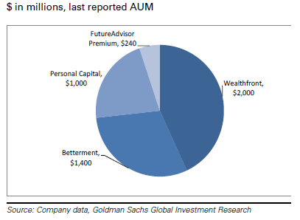
Market Shares of Largest Robo-Advisors

Slide 36
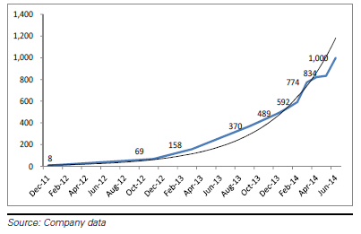
Growth of Wealthfront

Slide 37
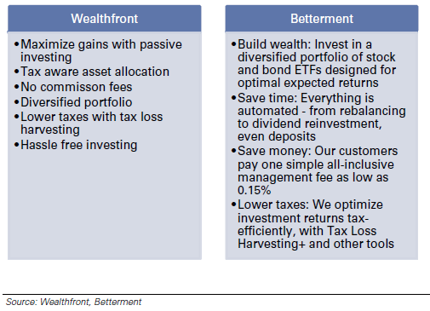
Benefits of Wealthfront and Betterment (as Advertised)

Slide 38
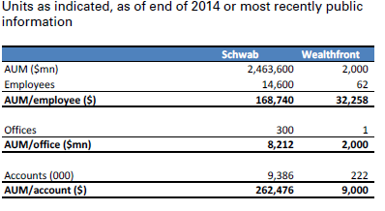
Charles Schwab vs. Wealthfront
Source: Goldman Sachs Equity Research

Slide 39
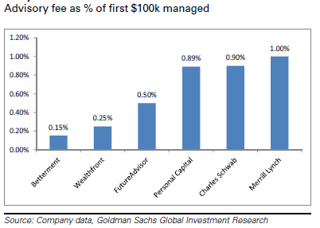
Comparison of Advisory Fees

Slide 40
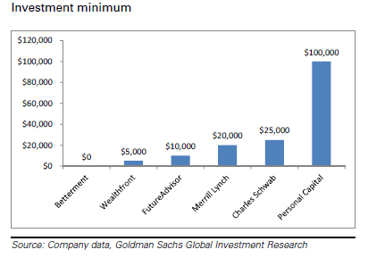
Comparison of Investment Minimums

Slide 41
Alternative or Marketplace Lending
Big Data on individuals and small businesses
Credit models that employ machine learning
Automation
Online and quick application
Reduction of costs
Changing demographics and network effects

Slide 42
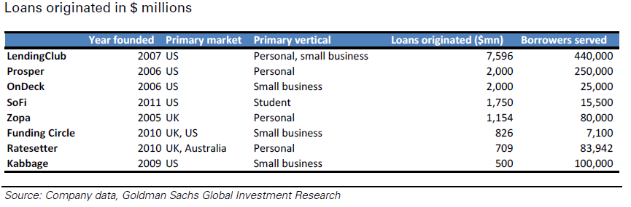
Marketplace Lenders

Slide 43
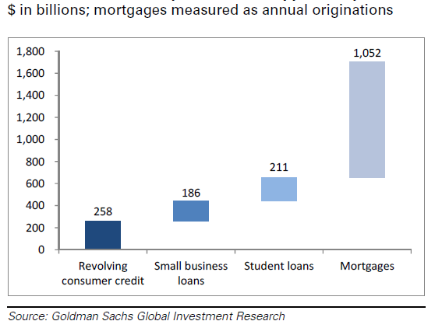
Immediately Addressable Markets by Marketplace Lenders

Slide 44
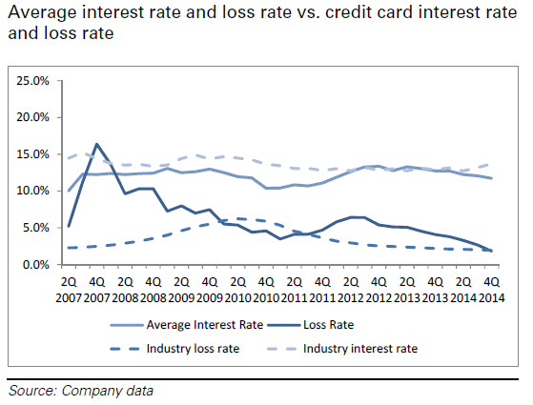
LendingClub Loan Performance

Slide 45
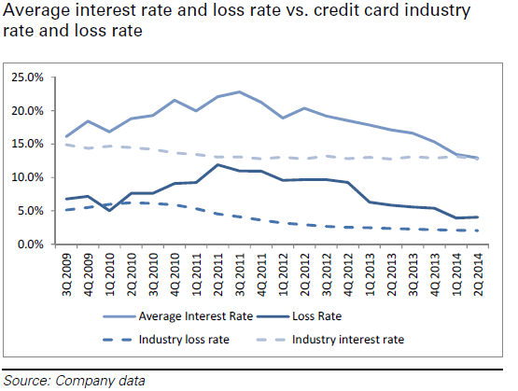
Prosper Loan Performance

Slide 46
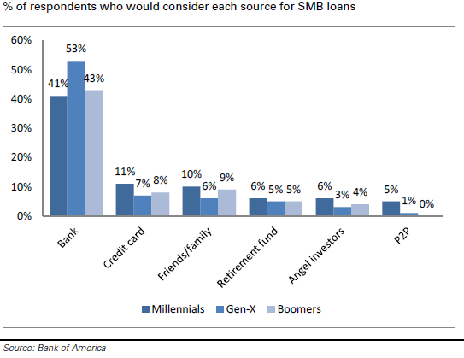
Small-Business Owners’ Attitude toward P2P Lending

Slide 47
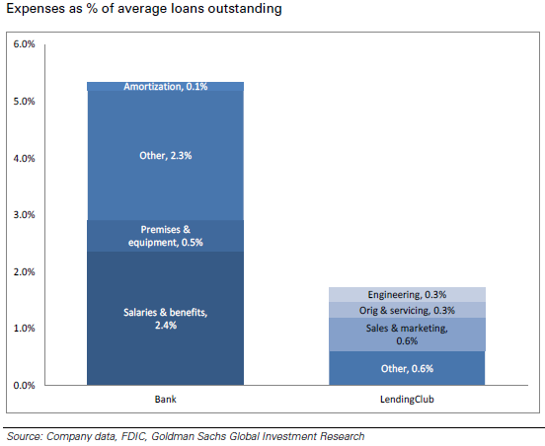
Operating Costs of Banks vs LendingClub

Slide 48
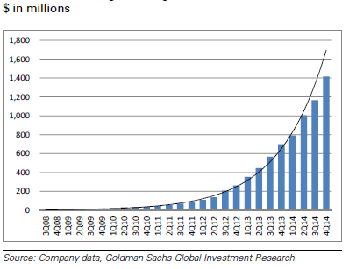
LendingClub Originations

Slide 49
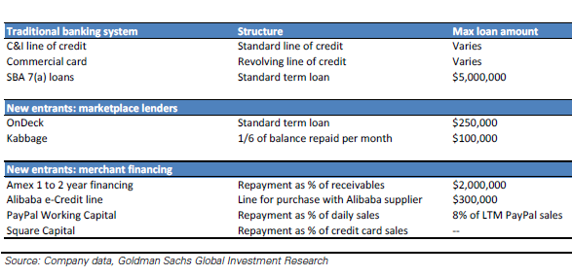
Merchant Financing

Slide 50
Digital Payments
Venmo facilitated nearly $2.4bn of payment in 2014
Digitization of money
Social network allows viral growth
Ease of use, lower costs, and faster transaction
International transfer is an underserved markets
Blockchain and cryptocurrencies (later)

Slide 51
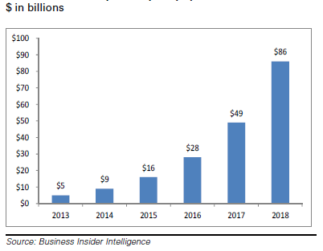
US Mobile Peer-to-Peer Payments

Slide 52
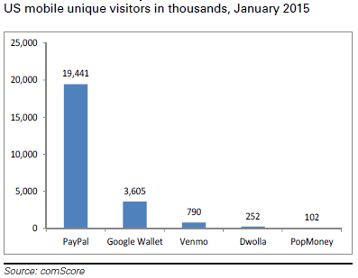
Mobile Unique Visitors

Slide 53
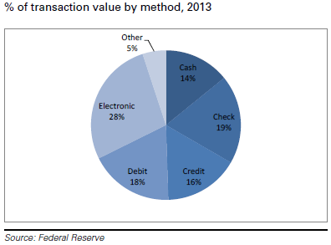
Electronic Makes Up 28% of Transaction Values

Slide 54
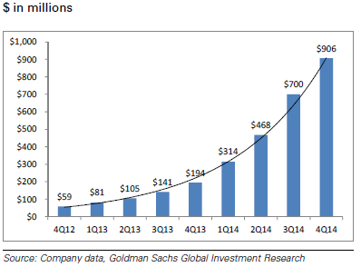
Venmo Mobile Payments Volume

Slide 55
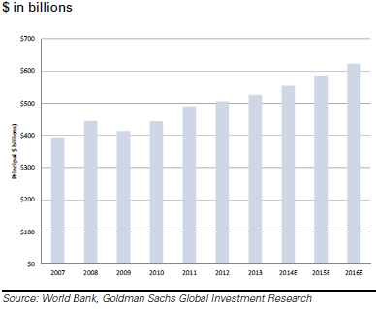
Size of International Money Transfer Market

Slide 56
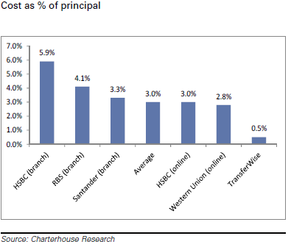
Cost of Sending £1000 from UK to Germany

Slide 57
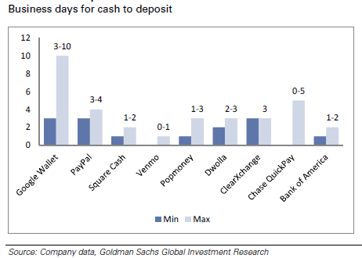
Transaction Time

Slide 58
Blockchain and Distributed Ledgers
Facilitate secure and decentralized transactions among multiple parties
Reduce fraud and increase trust
Increase transparency and efficiency in transactions

Slide 59
Blockchain Disruption
Payments/Cryptocurrencies: Bitcoin, Ethereum, Ripple, etc
Lending and Crowdfunding: Initial coin offerings
Brokerage and Exchanges: trade settlement on blockchains
Supply Chains
Healthcare
Insurance
Real Estate
Sharing Economy …

Slide 60
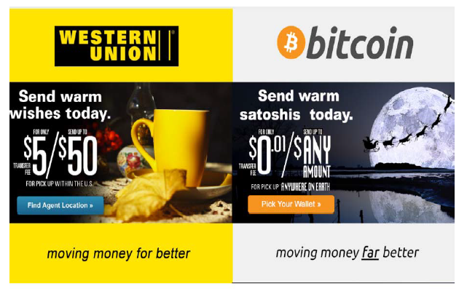
Western Union, we fixed your ad
Source: Campbell Harvey

Slide 61
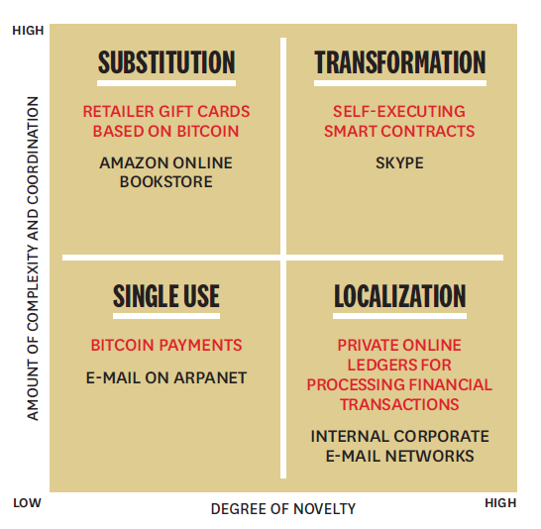
Disruption: Blockchain vs Internet
Source: The Truth about Blockchains, Iansiti and Lakhani, 2017, HBR

Slide 62
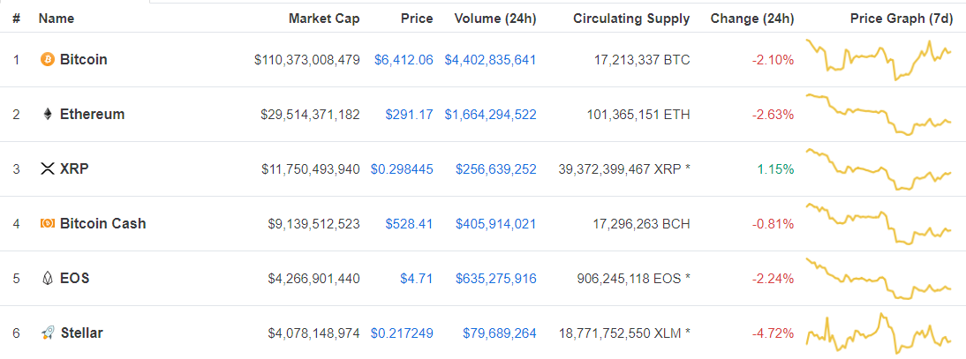
Cryptocurrencies
Source: coinmarketcap.com, August 2018

Slide 63
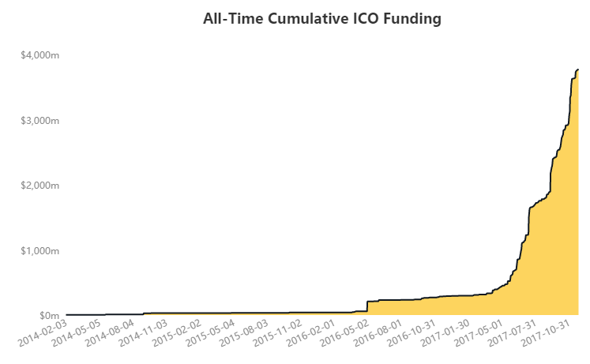
CrowdFunding through Initial Coin Offerings
Source: coindesk

Slide 64
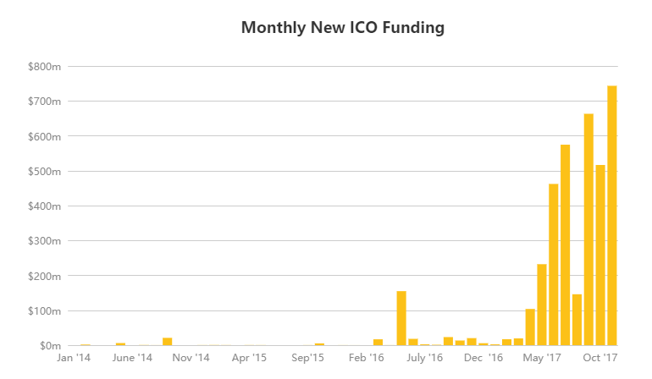
Initial Coin Offerings
Source: coindesk

Slide 65
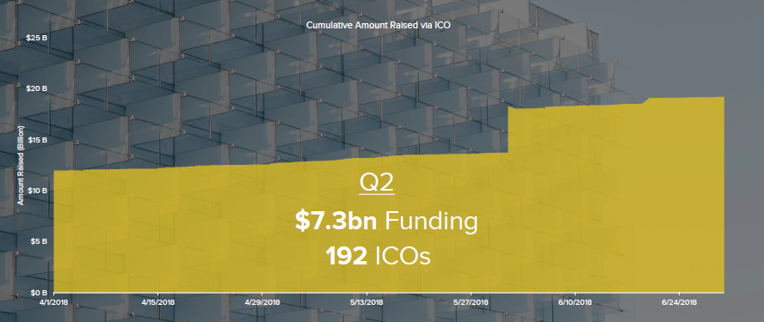
ICO funding in 2018 Q2

Slide 66

Annual Global VC Investments in FinTech

Slide 67

FinTech Unicorns

Slide 68

Source: CB Insights

Slide 69

FinTech Investment in Asia-Pacific

Slide 70

FinTech in China

Slide 71

FinTech in China

Slide 72

FinTech in China
Source: KPMG

Slide 73

Singapore: Basic Enablers of a Digital Economy

Slide 74

Regulatory Sandboxes in Singapore

Slide 75
Potential Challenges to FinTech
Incumbents can respond
Innovation and Competition
Acquisition
Partnership
Security and Performance
Regulation policies unclear in some areas
Lending platforms
Cryptocurrencies
ICOs

Slide 76

How Valuable Is FinTech Innovation? By Chen, Wu, and Yang (2019)
Using data on patent filings from 2003 to 2017, they provide large-scale evidence on the occurrence and value of FinTech innovation.
Source: Chen, Wu, and Yang

Slide 77

FinTech Innovation by Public and Private Firms
Source: Chen, Wu, and Yang

Slide 78

FinTech patent filings over time, by technology category

Slide 79

Industry Disruption (in $ millions) for FinTech categories by financial industry

Slide 80

Visa Acquisitions
Source: CB Insights

Slide 81

MasterCard Acquisitions
Source: CB Insights

Slide 82

Fintech Mergers by Wang and Zhang (2022)
We explores the motives and consequences of FinTech adoption through corporate takeovers.

Slide 83

Fin-Tech firms become highly sought-after in mergers and acquisitions (M&As).

Slide 84

Acquiring firms experience FinTech disruptions in the post-merger period.

Slide 85

We find significant value-creation of FinTech mergers.

Slide 86

FinTech mergers generate positive spillover effects on industry peers.

Slide 87

Incumbents’ Reaction to Automated Investment Service
Source: Investment News

Slide 88

AUM Growth Slowing

Slide 89
References
Global FinTech Report, CB Insights, The Future of FinTech, CB Insights
Chen, Mark, Qinxi Wu, and Baozhong Yang (2018), How Valuable is FinTech Innovation?
Joanna Wang and Alan Zhang (2023), Riding on the FinTech Wave: Disruption and Value Creation in Corporate Takeovers.
In FinTech, China shows the way, Feb. 25, 2017, the Economist
The Future of Finance, Goldman Sachs Equity Research, March 2015
Global FinTech Survey Report, PwC, March 2016
FinTech: the New DNA of Financial Services, Gupta and Tham

